Slide 1


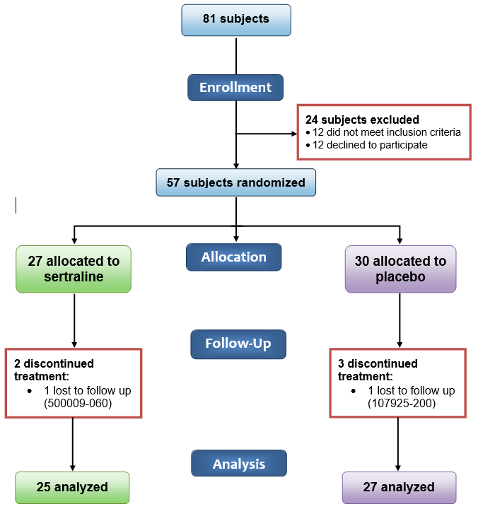
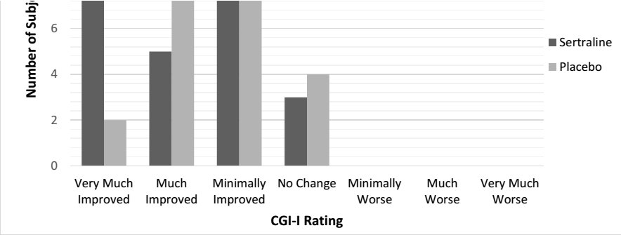
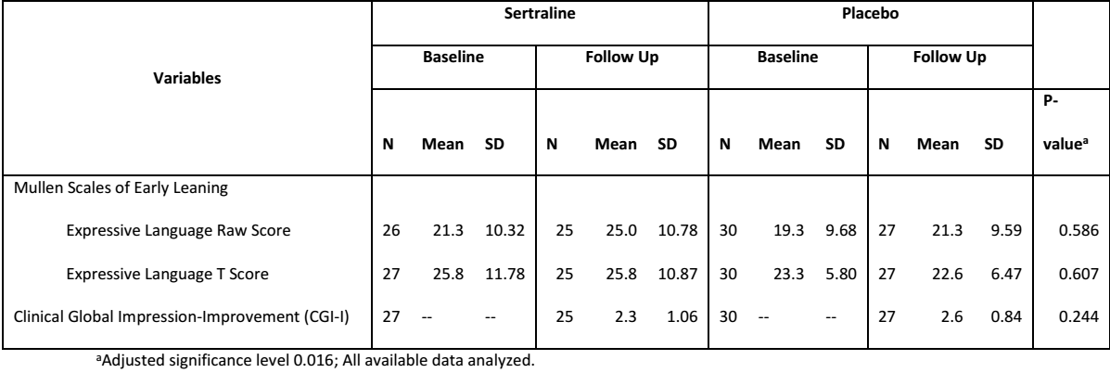
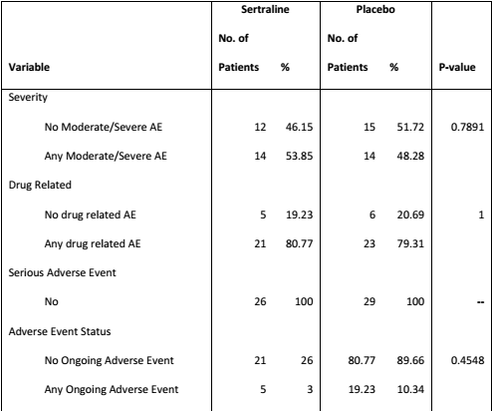
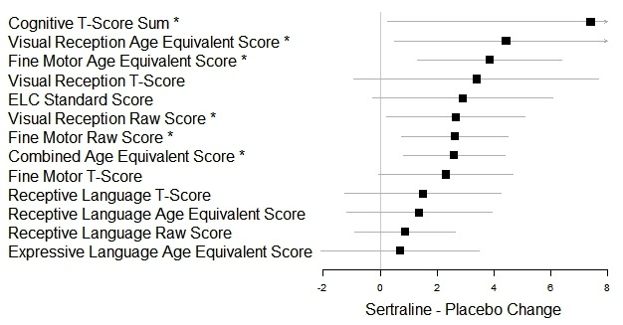
A Randomized, Double-Blind, Placebo-Controlled Trial of Low-Dose Sertraline in Young Children with Fragile X Syndrome
Randi Hagerman, Kimberly Gaul, Salpi Siyahian, Laura Greiss Hess, Sarah Fitzpatrick, Andrea Schneider, Jonathan Polussa, Marwa Eldeeb, Lawrence Willis, Jessica Burris, Avneet Kahlon, David Hessl, Susan Rivera, Danh Nguyen,Flora Tassone
UC Davis MIND Institute, Sacramento California; Research supported by HRSA R40MC22641
Introduction
Results
Results
Conclusions
The use of targeted treatments in adolescents and adults with FXS has not been efficacious; however there is emerging evidence that targeted treatments in young children may be more beneficial. This has been demonstrated in a controlled trial of arbaclofen and a trial of minocycline in children with FXS. A retrospective clinical study of sertraline, an SSRI that stimulates neurogenesis and raises BDNF and dopamine levels, was shown to improve both expressive and receptive language on the Mullen Scales of Early Development (Mullen).
Eighty-one subjects were screened for eligibility and 57 were randomized to sertraline (27) or placebo (30). Two subjects from the sertraline arm and three from the placebo arm discontinued. Intent-to-treat analysis showed no difference from placebo on the primary outcomes, the Mullen Scales of Early Learning (MSEL) expressive language age equivalent and Clinical Global Impression-Improvement (CGI-I). However, analyses of secondary measures showed significant improvements, particularly in motor and visual perceptual abilities and social participation. Sertraline was well-tolerated, with no difference in side effects between sertraline and placebo groups. No serious adverse events occurred.
Figure 1. Consolidated Standards of Reporting Trials (CONSORT) flow diagram of subject disposition
This randomized controlled trial of six-month of sertraline treatment showed no primary benefit with respect to early expressive language development and global clinical improvement. However, there were significant overall improvements, particularly in motor and visual perceptual abilities and social participation in young children with fragile X syndrome ages. Treatment appears safe. These results warrant further studies of sertraline in young children with FXS using refined outcome measures.
Objectives
Figure 4. Distribution of Clinical Global Impression-Improvement (CGI-I) score.
  To evaluate the benefit of Sertraline (a Selective Serotonin Reuptake Inhibitor) in the treatment of developmental delay and language delays in children with Fragile X Syndrome ages 24 to 68 months.
  Hypothesis 1: We hypothesize that sertraline will stimulate language, as documented by the Mullen Scales of Early Learning language scales, in young children with FXS compared to those who are not treated with sertraline.
  Hypothesis 2: Young children treated with low dose sertraline will not experience an increase in adverse effects compared to placebo.
Table 1. Primary efficacy results. Given are results for three pre-specified three outcome measures.
Figure 2. Effect size and 95% confidence intervals (CIs) for pre-specified primary outcomes measures. Given effect size are post treatment score difference estimates (sertraline minus placebo), adjusted for baseline measure, along with 95% CIs.
Selected References
Abbeduto L, Brady N, Kover ST. Language development and fragile X syndrome: Profiles, syndrome-specificity, and within-syndrome differences. Mental Retardation and Developmental Disabilities Research Reviews. 2007;13(1):36-46.
Berry‐Kravis E, Potanos K. Psychopharmacology in fragile X syndrome—present and future. Mental Retardation and Developmental Disabilities Research Reviews. 2004;10(1):42-48.
Kaufmann WE, Cortell R, Kau ASM, et al. Autism spectrum disorder in fragile X syndrome: Communication, social interaction, and specific behaviors. American Journal of Medical Genetics Part A. 2004;129A(3):225-234.
Hanson AC, Hagerman RJ. Serotonin dysregulation in Fragile X Syndrome: implications for treatment. Intractable & rare diseases research. 2014;3(4):110.
Materials and Methods
Table 2. Comparison of adverse events in sertraline and placebo groups.
A controlled double blind cross over trial of sertraline in young children with FXS lasting 6 months was carried out. A total of 57 children with FXS were enrolled ages 2 to 6yo. Baseline and outcome measures included the Mullen, Visual Analogue Scale, CGI, eye-tracking language task, Preschool Language Scale 5 (PLS), Vineland Scales of Adaptive Behavior, ADOS, Sensory Processing Measure-Preschool and Child Behavior Checklist. Five patients dropped out of the study after enrollment because of difficulties in returning to clinic or they were lost to follow-up. Biomarkers were obtained at baseline and at the end of the study and will be presented by Dr Tassone in another abstract.
Figure 3. Effect sizes and 95% confidence intervals (CIs) for exploratory secondary measures for the Mullen Early Scales of Learning (MSEL). Given effect size are post treatment score difference estimates (sertraline minus placebo) adjusted for baseline measure, along with 95% CIs (arrows indicate CI length truncated for display). P values are shown next to categories with an asterisk.
P=0.047
Acknowledgements
P=0.031
We are grateful to the families and patients who have participated in this research study. This work was supported by the Health Resources and Services Administration (R40MC22641), the MIND Institute Intellectual and Developmental Disabilities Research Center (U54 HD079125), and the National Fragile X Foundation. This publication was also made possible by grants UL1 TR000153 and UL1 TR001414 from the National Center for Advancing Translational Sciences, National Institutes of Health, through the Biostatistics, Epidemiology, and Research Design Unit.
P=0.005
P=0.038
p=0.008
P=0.007

